Slide 1

A Tool For Version Control
VINEETH CHIKKULAPALLY

Slide 2
Aim Of Project…
The aim of this software is to keep tracks of the different steps of C# source files. It will help developers to keep tracks of the evolution and historic of their projects.
The entire tool is based on C# programming with Winform GUI and the database used is Microsoft Access

Slide 3
Working…
Before running this program we have to run Access Database Engine .
After completing run Vcontrol.sln
For Admin login
User Id : admin
Password : admin

Slide 4
Configuration details
Change source file name before running program

Slide 5
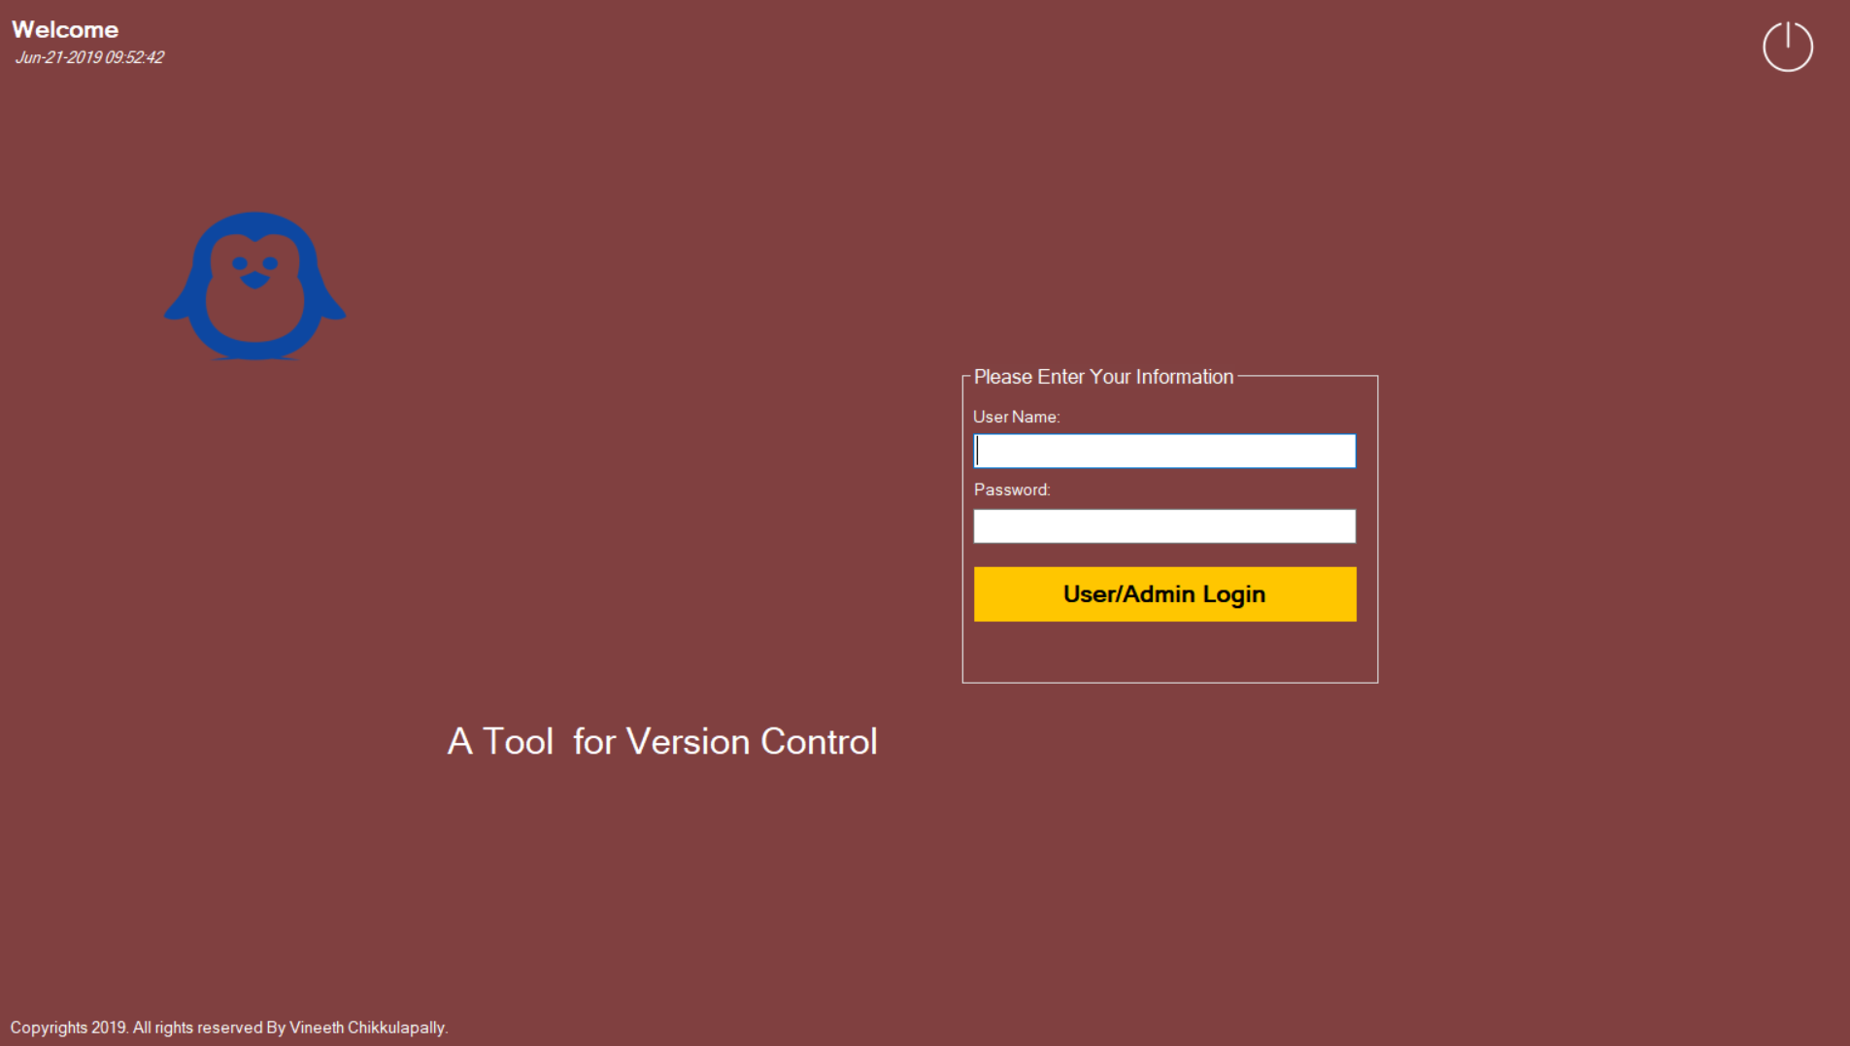
Welcome page…..

Slide 6
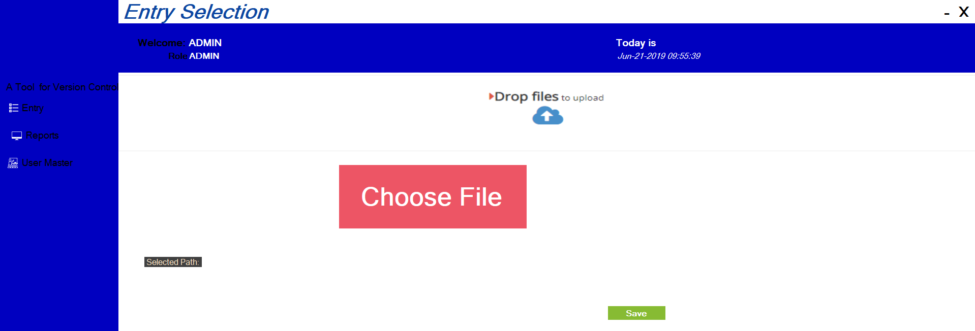
Admin Page….
After logging admin also can choose files to upload in
server

Slide 7
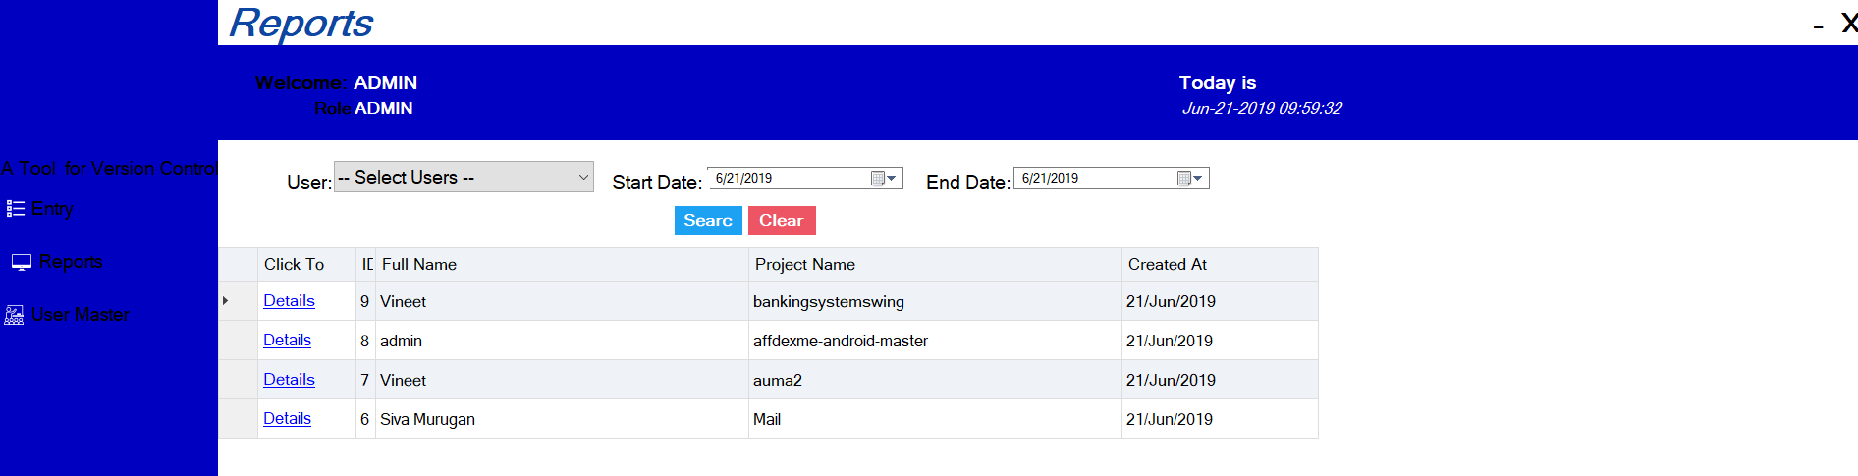
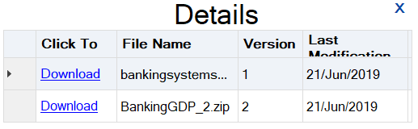
Reports Page…
By redirecting into reports admin can see user project details, name, project name, date or else he can search by filtering as shown in picture
Admin can see users project history
and he has rights to download

Slide 8
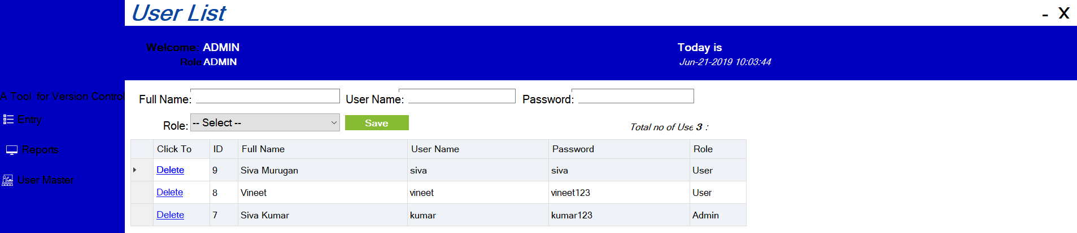
User List…
Admin can add Users and Delete as
shown in figure

Slide 9
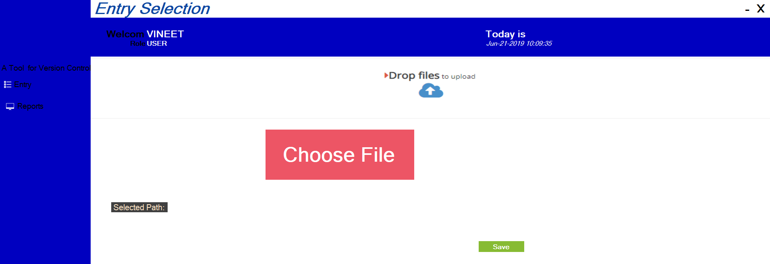
User Page….
User login home page
In home page as shown in figure User can upload his files and saveit.

Slide 10

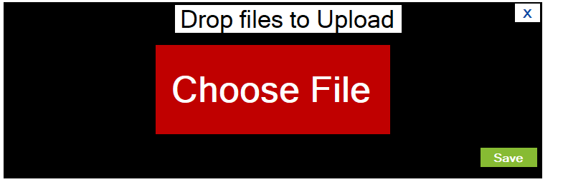
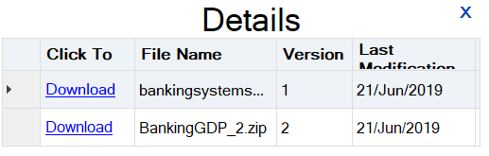
User page(Report)…..
To see user his history he can click on
Reports and he can see details like how
many versions he uploaded and he can add New version of the same project.
User can download his project

Slide 11
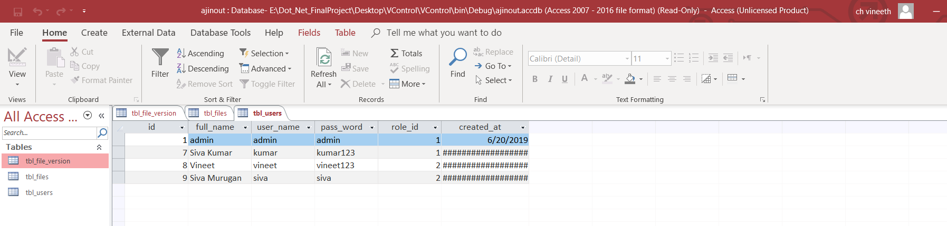
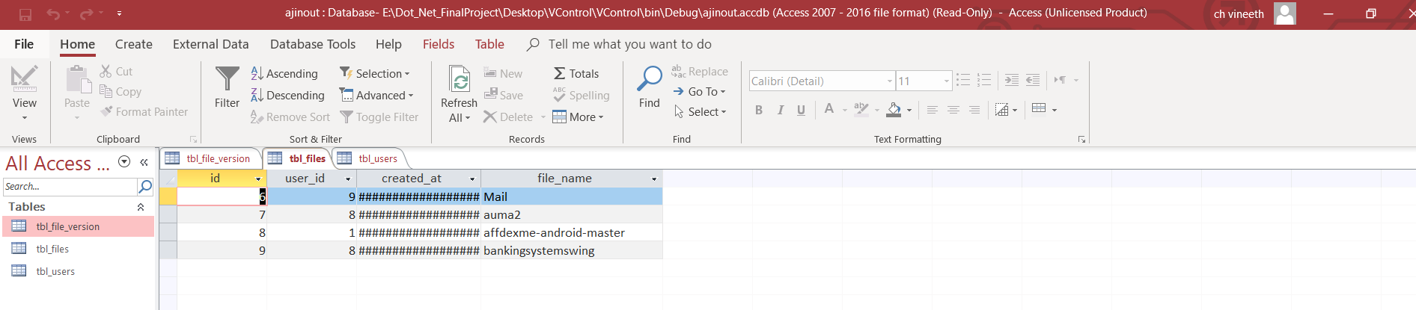
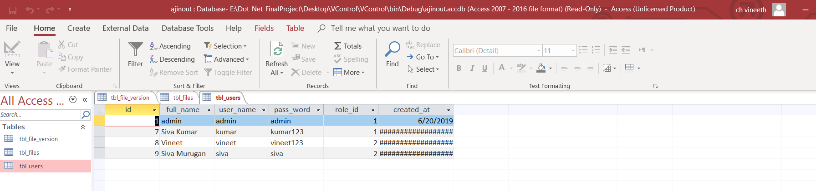
Database…

Slide 12
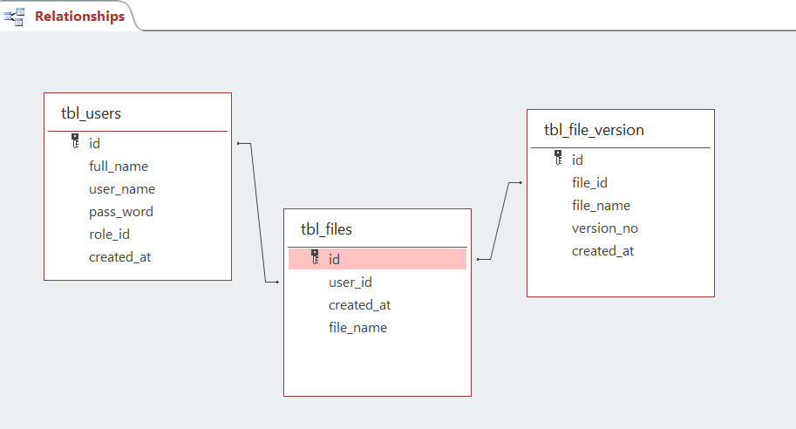
UML….

Slide 13
Thank You….

